Slide 1

Job title cleaning pipelines
Luca Gramaglia, Eurostat unit 02
Statistical Scraping Interest Group meeting, April 16 2026

Slide 2
Eurostat’s Web Intelligence Hub
Eurostat started investigating the use of web scraping for European statistics in 2017. In 2020 Eurostat established the Web Intelligence Hub (WIH). The WIH provides the infrastructure and expertise to support the use of web content for European Statistics.
Over the years, the WIH has explored several use cases. Two use cases have reached a higher level of maturity: online job advertisements (OJAs) and online business enterprise characteristics (OBEC).
Online prices
Most mature
use-cases
Construction
activities
Tourism
Online job advertisements
OJA
Experimental use-cases
Real estate
Traffic cameras
Enterprise characteristics
OBEC

Slide 3

Web Intelligence Hub - Online Job Advertisements
Online Job Advertisements (OJA) from job portals have been identified as a promising data source to track the labour market demand for occupations and skills.
Since 2020, Eurostat has established and maintained a pipeline for the collection and processing of online job advertisements. Eurostat currently publishes two experimental statistics using online job advertisements data:
Job vacancy rate by occupation and region
Labour market demand for ICT specialists in OJAs
Landscaping
Content Collection
Pre-processing
Information Extraction
Statistics Production
Details on the OJA data collection are available on Eurostat's CROS portal.

Slide 4
OJA Job Titles
Online Job Advertisements (OJA) from job portals generally have a job title for each published vacancy.
Job titles play a particularly important role in identifying occupations and their evolution:
They are less semantically rich than job descriptions, but less intensive to analyse (for both machines and humans)
Can be used to update the index of occupational titles associated to ISCO as new occupations emerge
However, raw job titles are often difficult to analyse directly. The same occupation may be advertised using many different formulations, and titles may also contain information that is not part of the occupation itself, such as the location, employer name, working hours or other contextual details.

Slide 5
Raw job title example
accountant – Lisbon
Occupationally relevant
Occupationally irrelevant

Slide 6
Job title cleaning pipeline
Extract distinct raw titles
Canonically normalise titles
Standard, deterministic normalisation (use lowercase, collapse repeated punctuation / spaces etc.)
Extract distinct tokens from raw titles
Classify tokens by occupational relevance
Using LLMs for this assessment
Remove irrelevant tokens
Aggregate and rank top cleaned titles by occupation

Slide 7
Step 4 – Classifying tokens by occupational relevance
Each token is classified according to occupational relevance via LLM prompting:
Core occupational term — directly names an occupation, role, profession, or trade.
Occupational specialisation or domain — narrows the role by sector, subject area, product, technology, population, or functional domain.
Potentially useful modifier — seniority, responsibility, level, or another modifier that may improve occupation classification.
Non-occupational context — location, employer, organisational unit, recruitment wording, vacancy metadata, benefits, schedule, or promotional language.
Unclear / context-dependent — insufficient evidence for a safe token-level decision.
Each token classified once – may lead to some decisions that are not fully context-aware.

Slide 8
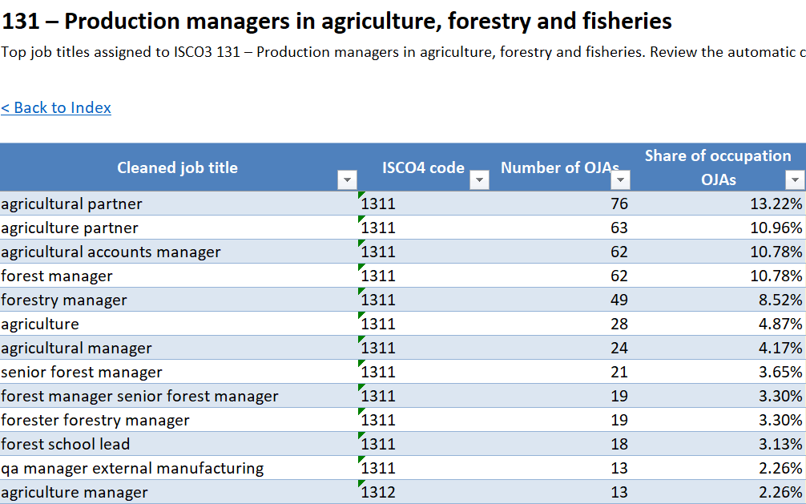
Step 6 - rank top cleaned titles by occupation
Top 50 cleaned titles for each ISCO occupation (level 3) were compiled for each language covered by Eurostat’s OJA data collection.
The list will be sent for review by labour market experts in NSIs (LAMAS working group) with the objective of identifying the occupations were misclassifications are more prevalent.

Slide 9
Availability and next steps
Code available on Commission’s Gitlab – can be shared with NSIs upon request.
Different development / improvement directions being explored, e.g.:
Evaluating the quality of the cleaned job titles vs original job titles
Context-sensitive treatment of ambiguous tokens
Better handling of multilingual job titles
Semantic merging / de-duplication for very similar cleaned titles
The list will be sent for review by labour market experts in NSIs (LAMAS working group) with the objective of identifying the occupations were misclassifications are more prevalent.

Slide 10
Updates on other topics – PII redaction
10

Slide 11
OJA data collection and personal data
As per the GDPR, personal data refers to any information relating to an identified or identifiable natural person (‘data subject’).
We call Personally Identifiable Information (PII) any data that can be used to identify a specific individual, either directly or indirectly, and includes things like names, addresses, social security numbers, biometric identifiers, email addresses, and many other data​
Eurostat’s OJA data collection does lead to the collection of several types of PII :​
Names of people (first names, family names)​
Social profiles URLs (LinkedIn, Instagram, Twitter, X, TikTok, Facebook)​
Phone numbers​
Email addresses

Slide 12
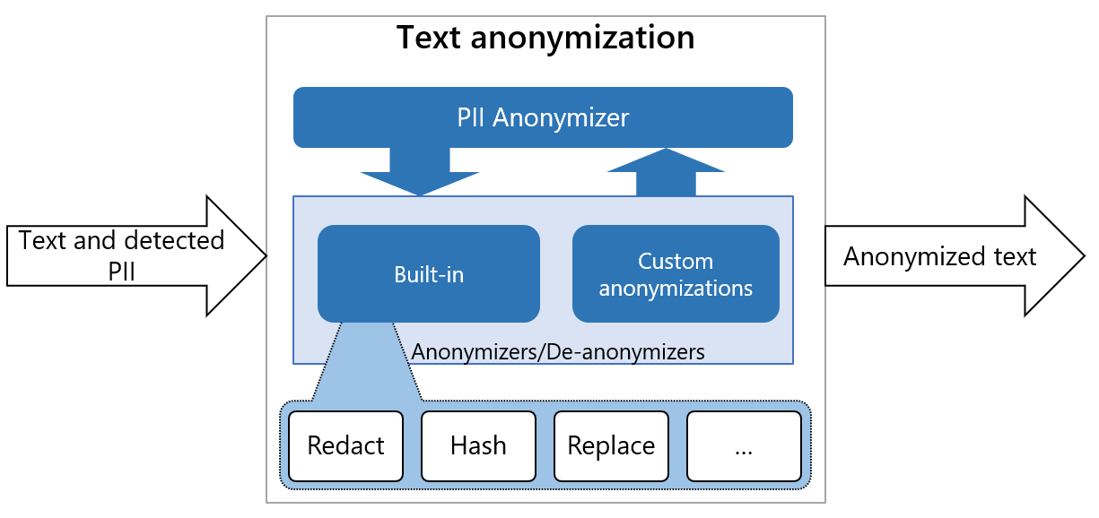
PII redaction using PRESIDIO framework
Status: PII redaction has been applied to the so-called “NLP sample” for years 2024 and 2025 (sample of job descriptions to be made available for research / scientific purposes)

Slide 13
Thank you
Fill in copyright information.
© European Union 2025
Unless otherwise noted the reuse of this presentation is authorised under the CC BY 4.0 license. For any use or reproduction of elements that are not owned by the EU, permission may need to be sought directly from the respective right holders.
Slide xx: element concerned, source: e.g. Fotolia.com; Slide xx: element concerned, source: e.g. iStock.com

